Slide 1
Automated Robotic Gardener
Middle Term Demo
Department of Electrical and Computer Engineering
University of Central Florida
Group 12 - Dr. Richie
Seana Falvey, EE
Wallace Borges, CPE
Rafael Smith, CPE
Denver Lau, CPE

Slide 2
Objective Statement
Our project is an automated garden mechanism which performs maintenance on a garden through checks in plant vitals

Slide 3
Specifications
AI | 70% or greater mean average precision
Camera | The system should be able to display 256x256 pixels minimum.
Watering | The system should be able to convert moisture levels to a digital readout an accuracy of 15%.
Movement | The gantry should be able to move in two directions with a precision of at least 0.5 inch.
Communications | Transfer images, user commands, data to external device via Wi-Fi within 5 seconds.
Notes:
Average precision is a metric that measures the accuracy of an object detection AI with localization(where is weed) and classification(is it weed)
For future water: maybe for final say that we raised the water moisture level by a certain percentage
Movement: in two directions

Slide 4
Hardware Integration

Slide 5
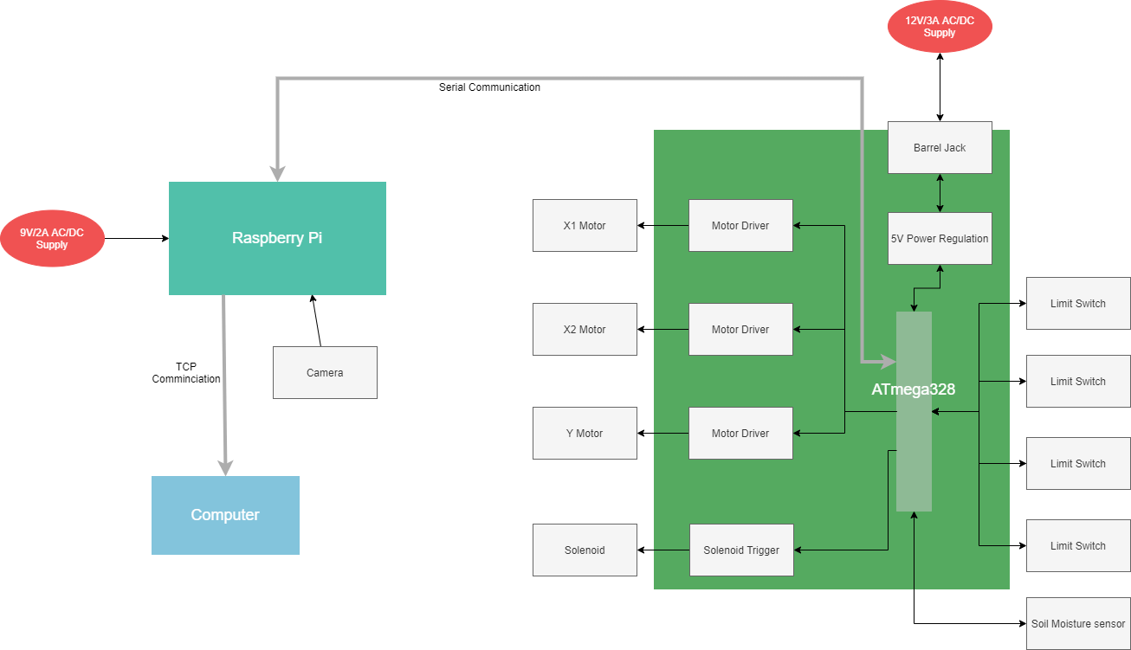
Hardware Integration Block Diagram

Slide 6
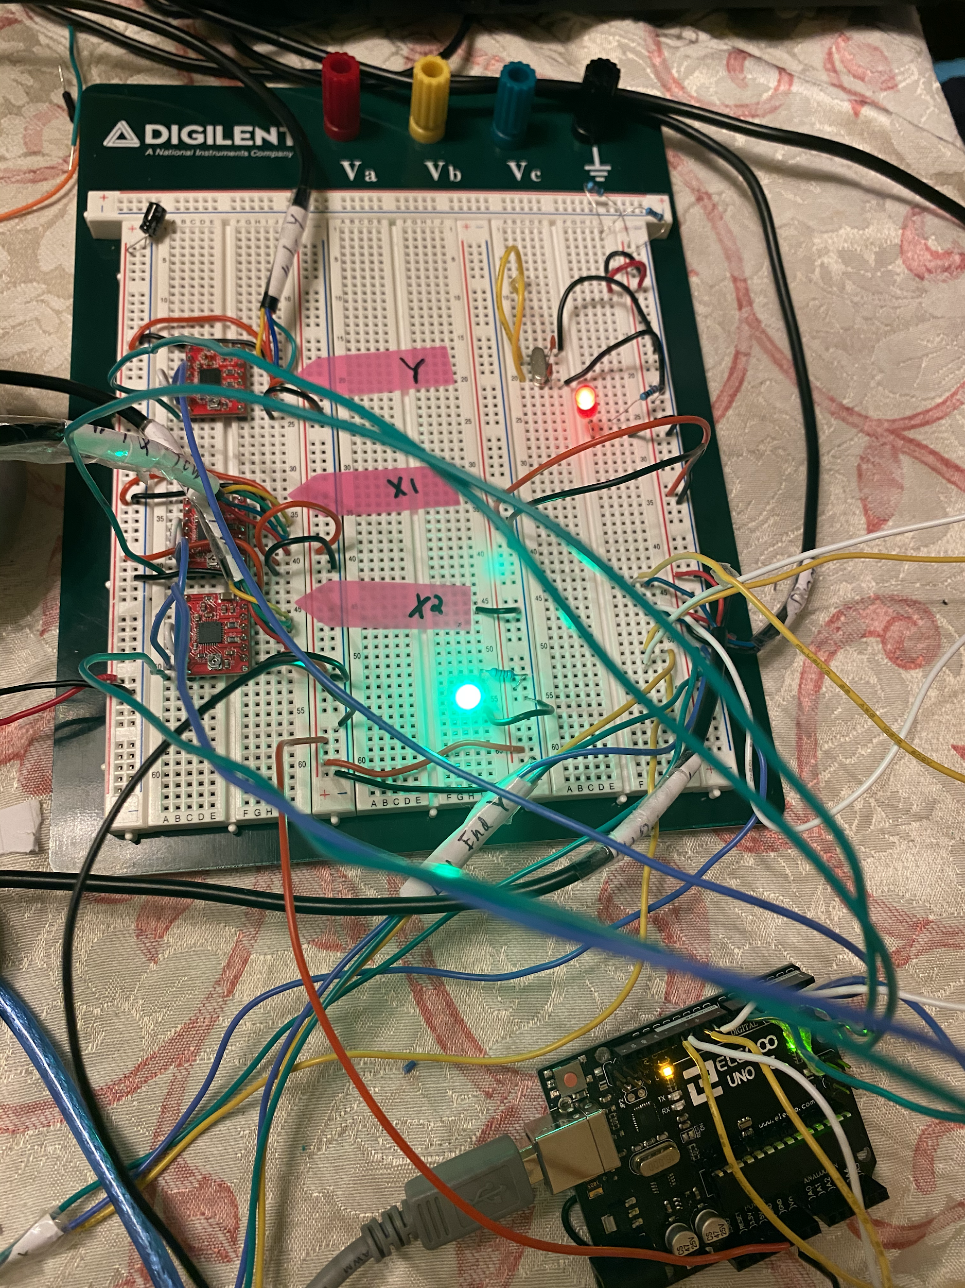
Breadboard Demo

Slide 7
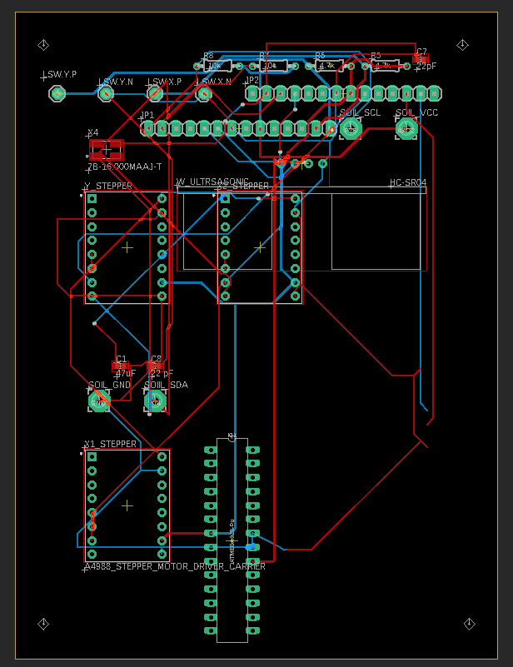
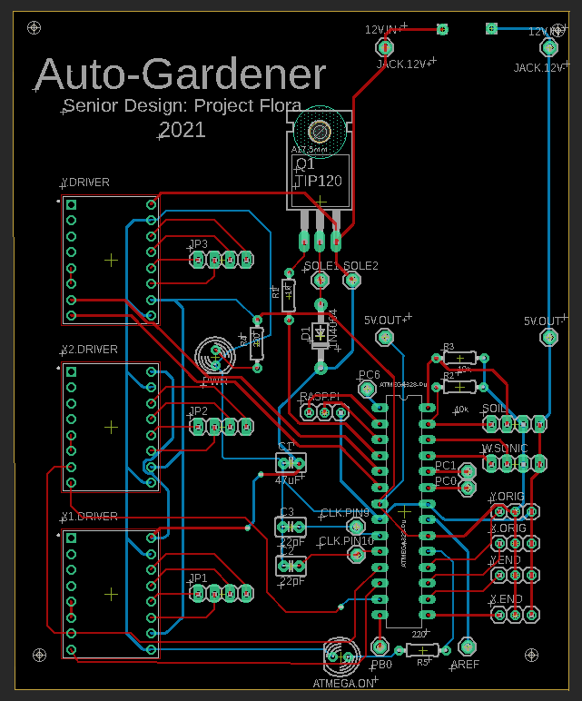
Old → New Design
Notes:
Things we had to change: add pin headers for the motor’s coil pins connected to the drivers. Changed the capacitors to be through hole, added LED circuit for power and for the microcontroller “ON” state, corrected pull-up resistors for the SDA and SCL lines, made sure everything is connected to power, made sure everything is grounded, made sure there was enough clearance for the traces, added extra pin pads to ATmega as a precaution, added an area for the buck converter to be soldered, and tried to condense overall design.

Slide 8
Issues we overcame with the ATmega chip by itself
Even though this seems like a simple blink program, we had to solve multiple issues:
Invalid signature error - had to download an additional board manager
Had to bootload the Atmega chip despite purchasing a chip with a bootloader
FTDI not working to upload code
External clock circuit issues

Slide 9

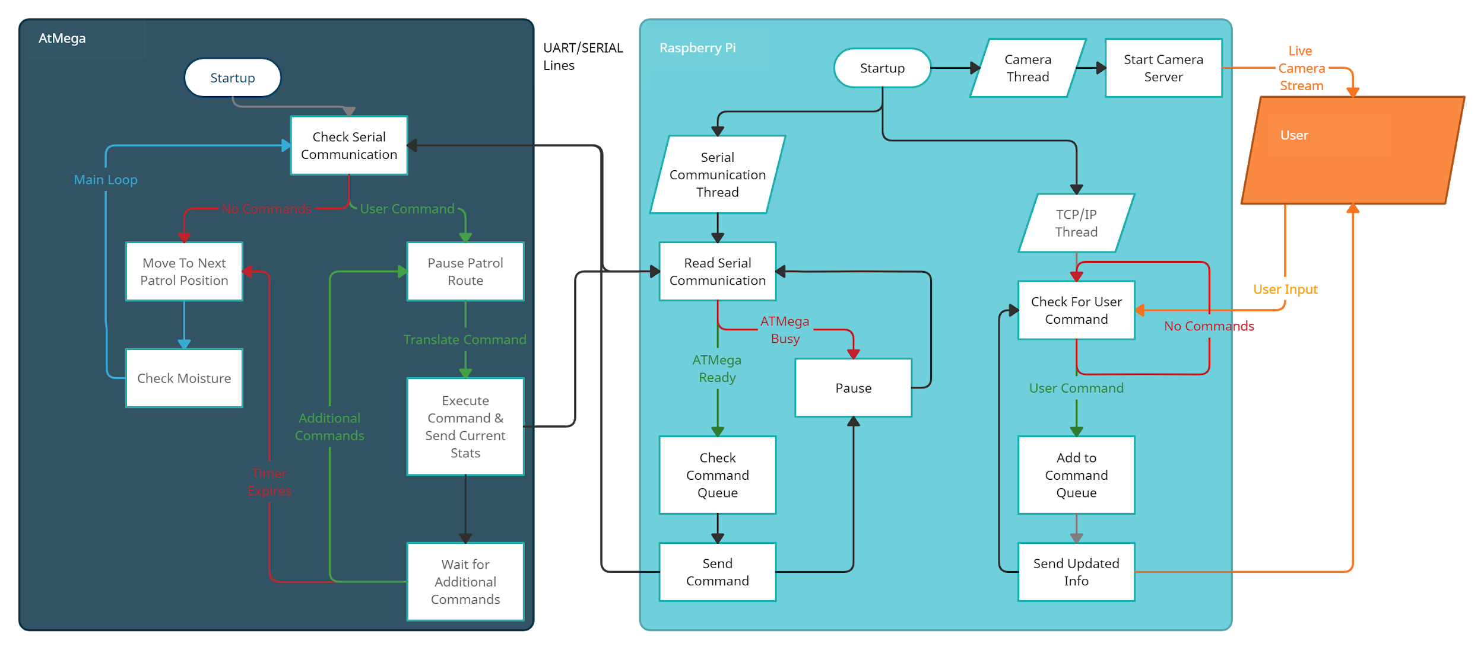
Software Integration
Notes:
This block diagram gives a simplified overview of the software for our three main components: the ATMega, the Raspberry Pi and the Desktop application represented simply as User. The primary loop for the ATMega is to check for an user commands then move to the patrol position. The raspberry pi starts up 3 separate threads to handle the major tasks: one for the Serial communication to the ATMega, one for the TCP/IP communication to the user, and the third to handle the video streaming

Slide 10
Platform Programming Languages
C/C++
•Arduino functions controlling motors/camera
•Microcontroller ATMega functions
•Serial communication between Arduino and Raspberry Pi
Python
•Artificial Intelligence (AI) systems
•Dataset Generation and Annotation
•Desktop/Mobile Application
•Communication with database
MySQL
Database holding pictures, timestamps, and data outputted from sensors
Notes:
For our project we are using C/C++ to program our ATMega, Python for our Raspberry Pi, Desktop Application and Image Recognition software, with MySQL acting as our information storage Database

Slide 11
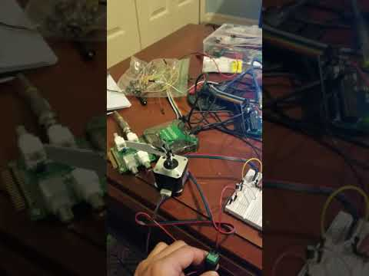
Motor Testing Demo
Notes:
This was one of the first component testing we did, just ensuring that the motors and motor drivers worked.

Slide 12

Patrol Routine Demo
Notes:
In this video we demonstrate the patrol routine where the ATMega microcontroller sends the gantry to 10 predetermined locations, pausing each time in order to give the Raspberry pi sufficient time to take a picture for analysis. In order to ensure accuracy the gantry returns to the origin where two limit switches are located. Since the only way to determine distance is by measuring how long the motors receive power. There is no feedback or data from the motors if any track slippage occurs.

Slide 13
Software Commands Demo
Notes:
This demo shows the ability of the ATMega to receive user commands over the Serial Communication Interface. Each time the ATMega receives a command it will pause the patrol routine, return to the origin then travel to the desired coordinates. Since the ATMega pauses the patrol, it will continue to listen for additional commands until a preset time limit is reached, with the idea being that a user would often send multiple commands in a short time period.

Slide 14
Live Video Streaming Demo
Notes:
This clip demonstrations the Raspberry Pi’s ability to stream the camera feed using mjpg format to our desktop application. For a pleasant user experience we wanted to make sure the delay was at a minimum

Slide 15
AI

Slide 16

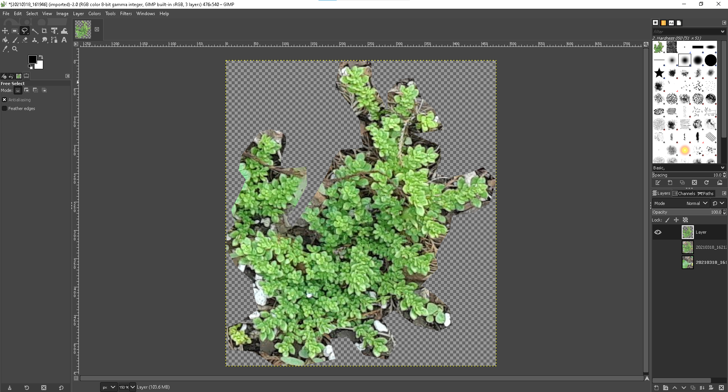
Custom Dataset Collection
57 different backgrounds
90 weed/plant foregrounds
Images were taken from a combination of the internet and surrounding areas (phone photos)
Images were cropped using GIMP
2400 images were separated into 80-10-10 split training/test/validation
Google Colab for Training
GPU: Tesla T4
GIMP Image Cropping

Slide 17
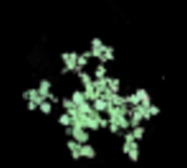
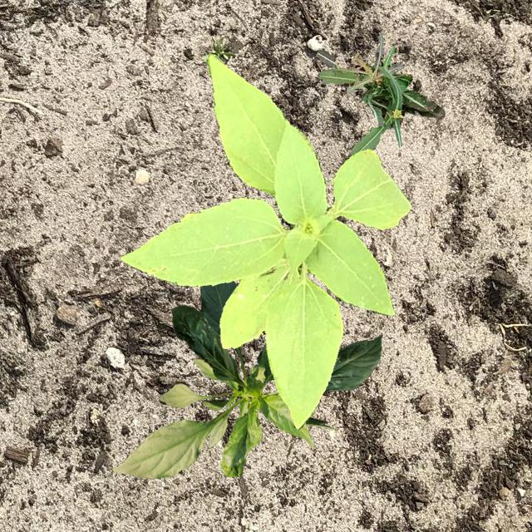
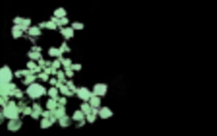
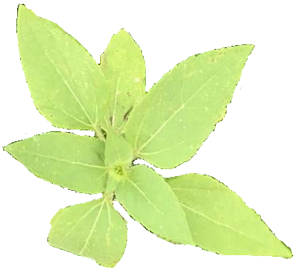
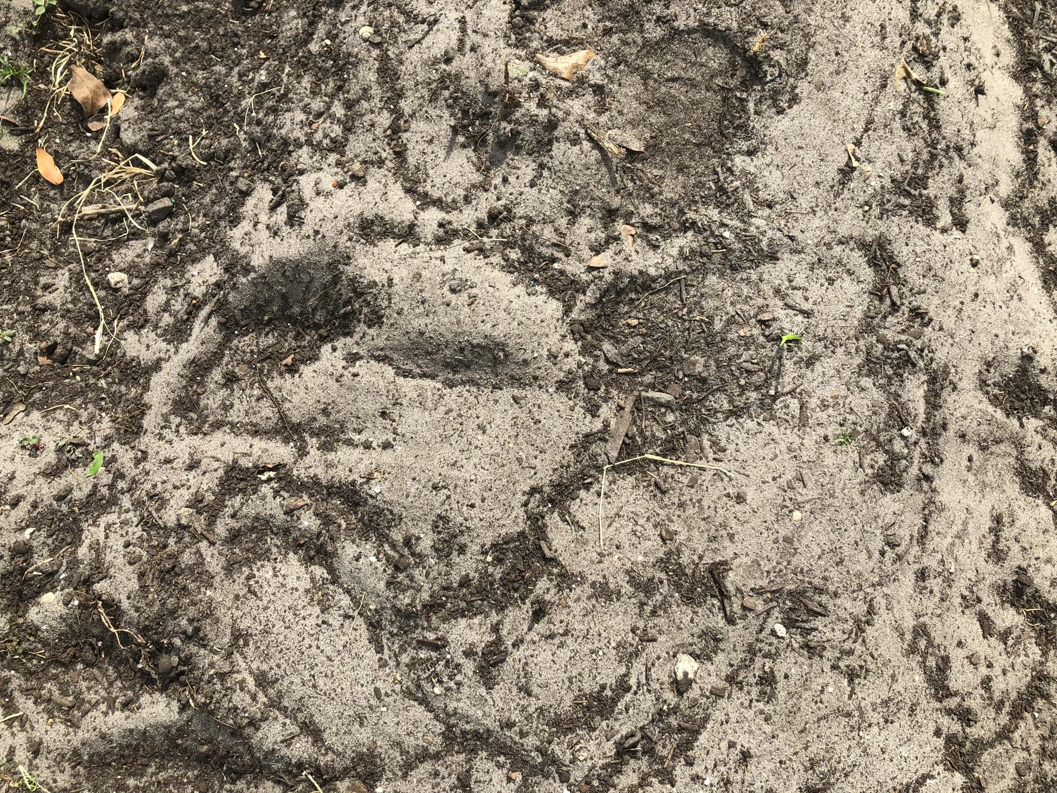
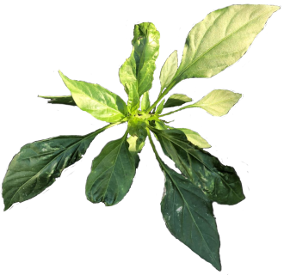
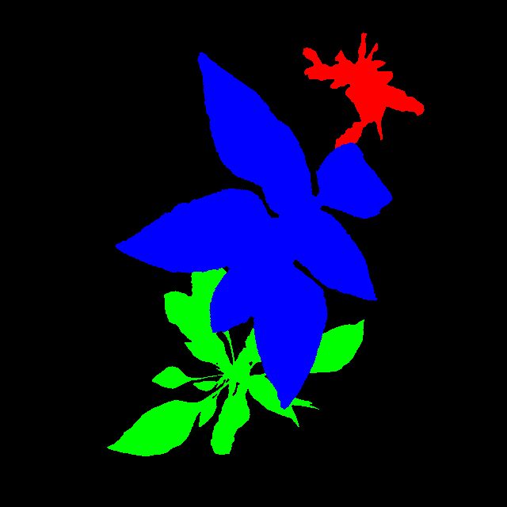
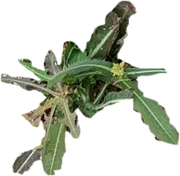
Image Creation
Synthetic Image
Backgrounds
Foregrounds
Image Mask

Slide 18
YOLO v4
Object Detector
Notes:
Do we want to talk about multithreading

Slide 19
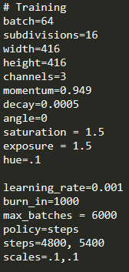
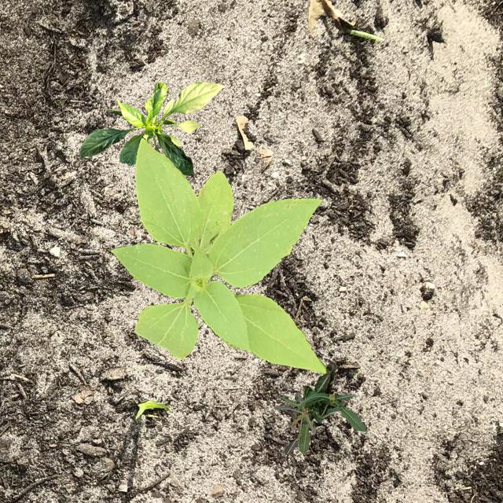
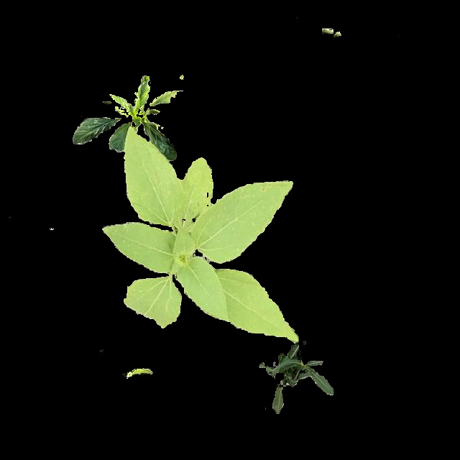
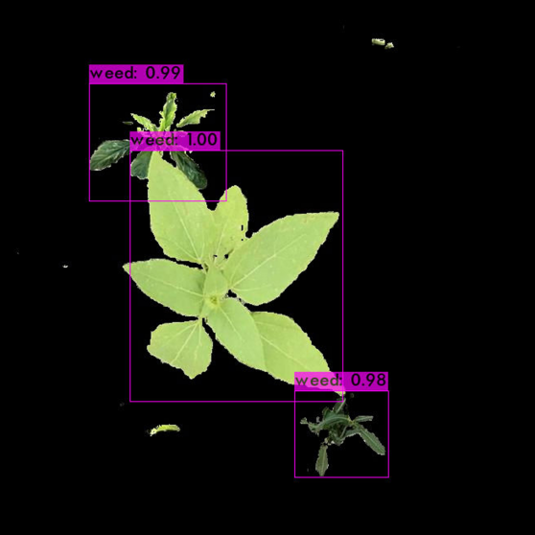
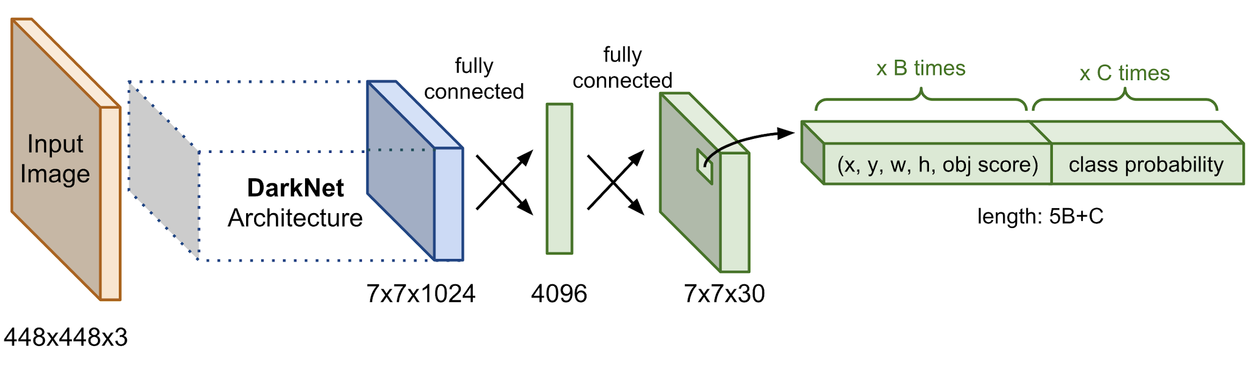
YOLO v4
Output
Input Image
Yolo v4 Architecture
Trained on 2000 416x416 images
1440x1080
6000 epochs,
~10 hr training time on Google Colab

Slide 20
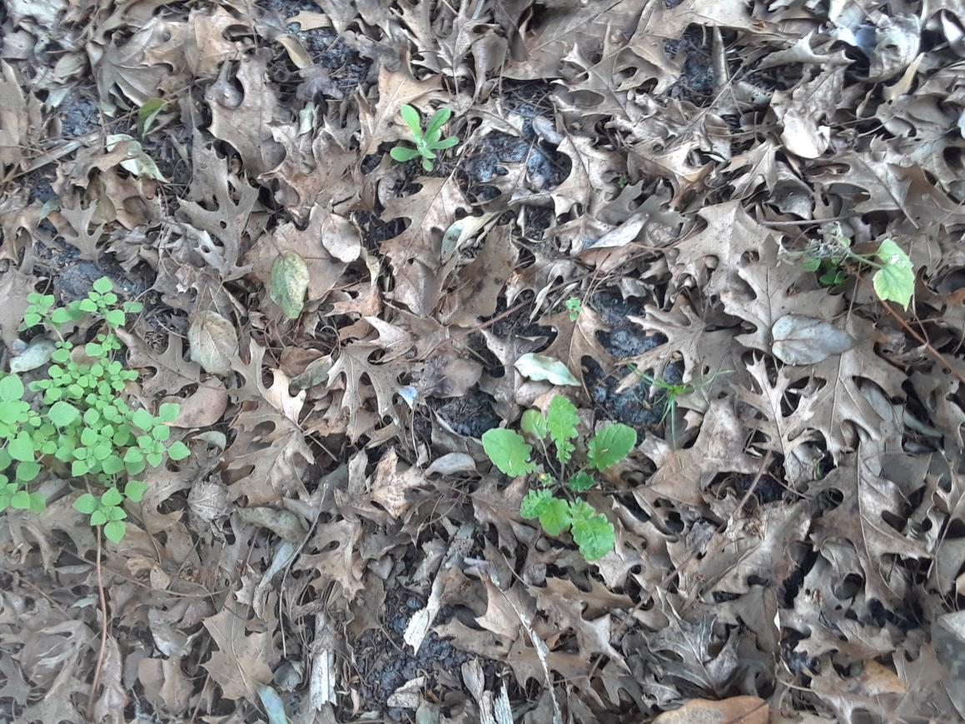
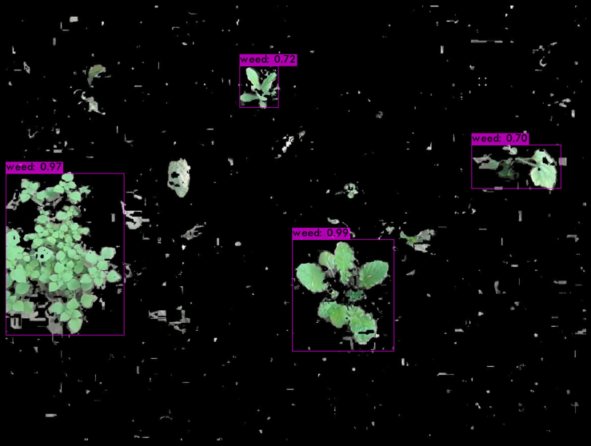
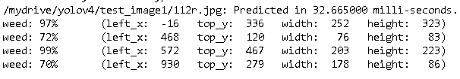
Test Image #1
Bounding Box Coordinates

Slide 21
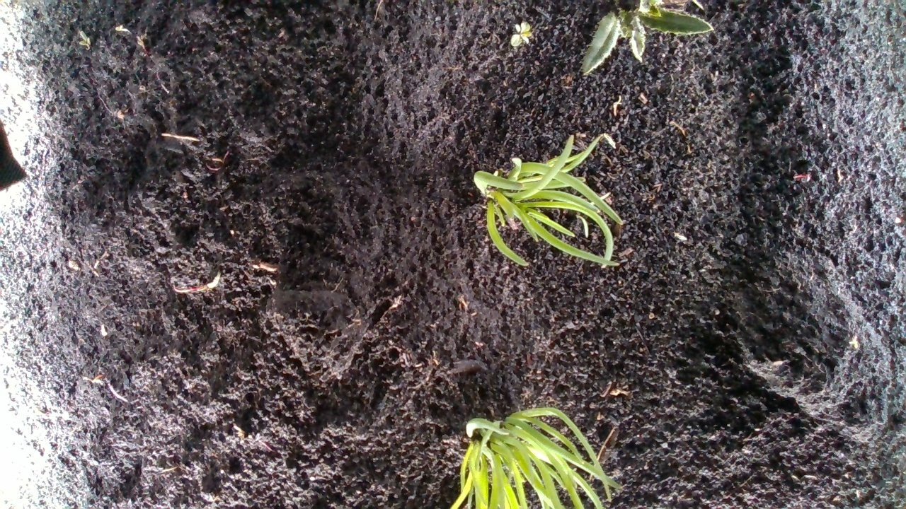
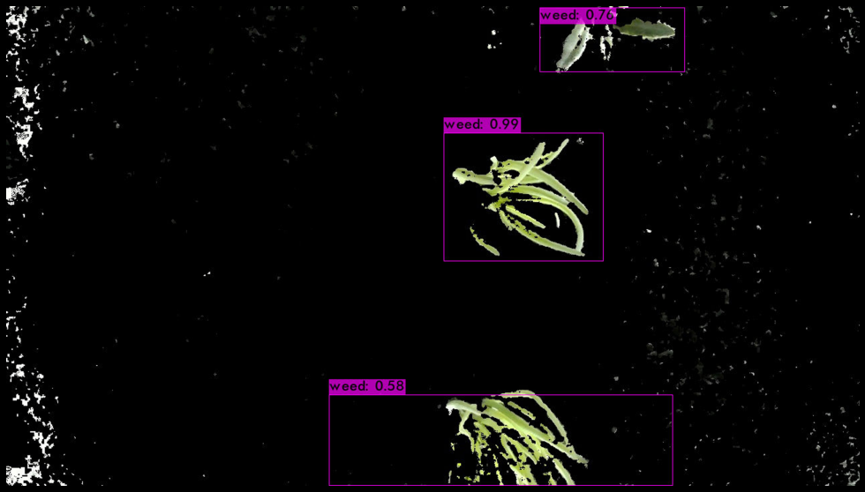
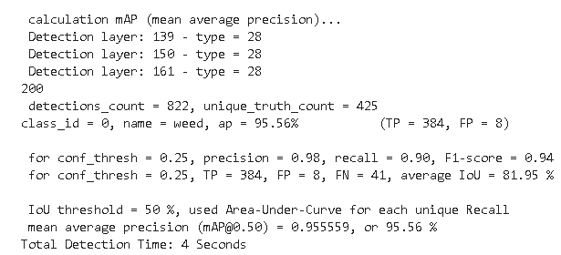
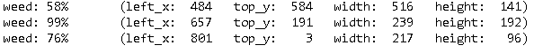
Test Image #2
Bounding Box Coordinates

Slide 22
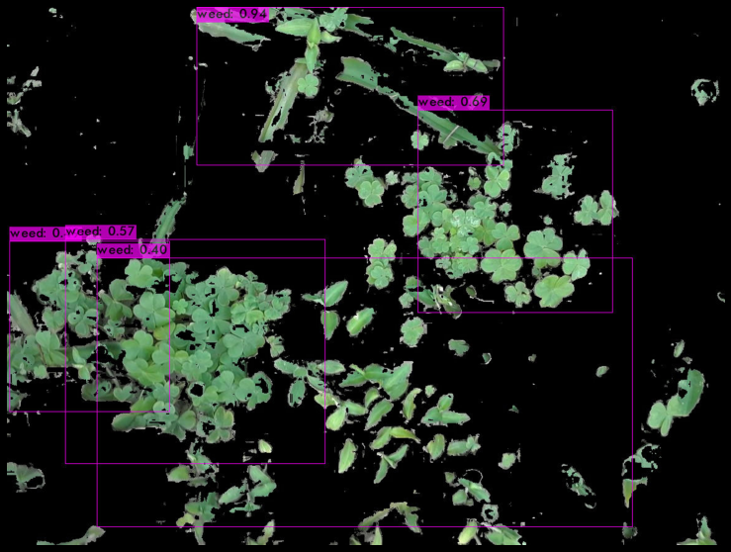
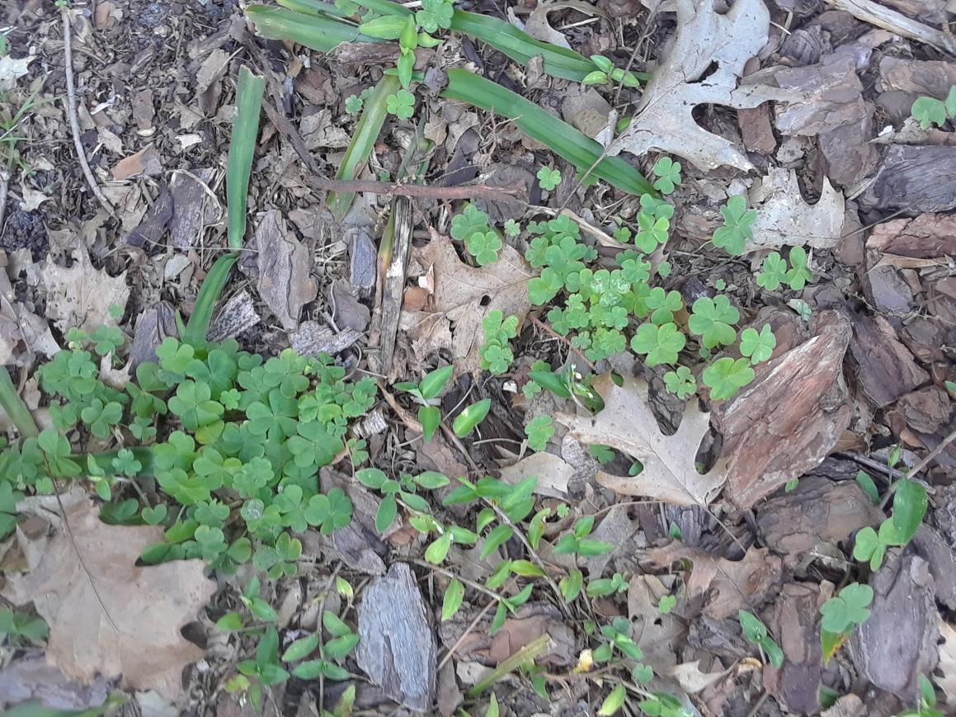
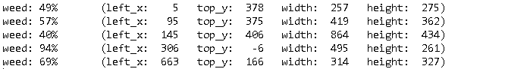
Test Image #3
Bounding Box Coordinates

Slide 23
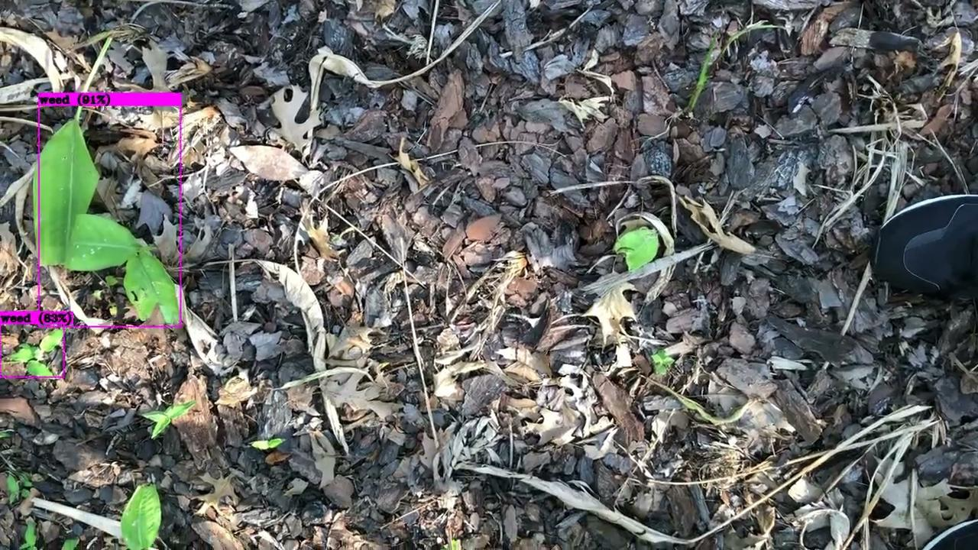
AI Video Test

Slide 24
Accuracy Metrics
Testing on 200 synthetic images
95.56% mAP (Mean Average Precision)
Standardized Measurement for Object Detectors
Verifies Classification and Localization
IoU of 50% (Intersection of Union)
Testing on 200 images
Weed is correctly detected when predicted and truth bounding boxes overlap by over 50% (IoU = 50%)
95.56% mAP (Mean Average Precision)
Common Measurement for Object Detectors
Verifies Classification and Localization

Slide 25
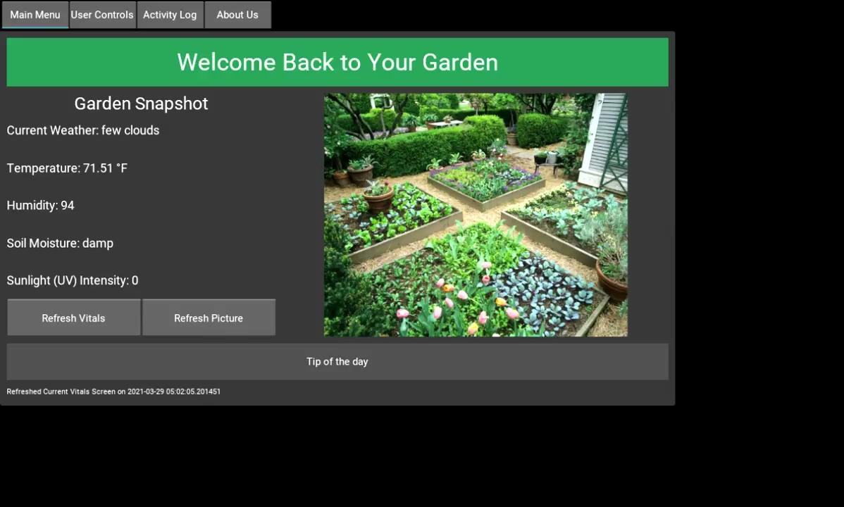
Web App Demo
Notes:
Use Demo2.mp4 This video will demonstrate the functionality and design of our Web Application. We use the Kivy framework to create an app that provides a user interface that communicates with our device through the internet. Our design uses tab switching to navigate the different screens, which include the main menu, the User controls, the activity log, the settings, and the about us section.
Tab switching, Main Menu Controls, Weather, Activity Log, About

Slide 26
Issues
Getting DC motors to work
PCB
Breadboard
Water Pressure on Solenoid
Multithreading with Raspberry PI
Notes:
We encountered many issues along the way. The most prominent and recent ones are listed below, affecting both hardware, getting the DC motors to work after a bout of rewiring caused them to stop working, and software, problems with multithreading and Raspberry Pi configurations

Slide 27
Moving Forward:
Full Integration
Integrating With PCB
Building Gardening Area to grow vegetation
Adding AI functionality to App
Database
Watering
Notes:
Our plans moving forward are to correct any bugs/kinks and fully implement all parts of our design. We intend to integrate the new design of the PCB, build a gardening area for our device to monitor, adding the AI functionality to our app in a user-friendly interface, expand usage of our database, and implementing the watering system to our garden area

Slide 28
Thanks for watching!
Don’t forget to like and subscribe ;)
Notes:
Thanks for watching our demo. Stay tuned to see the final release of our autogardener.

Slide 29
Moving Forward:
Full Integration
PCB
AI on laptop
Raspberry Pi Camfeed photos saved offline
Saved Logs of Historical Data
Database
Improving AI
Redoing Senior Design 2 documentation
Growing plants and weeds
Adding water source/solenoid
Grid System
User Account/Improve UX
Raising device
Designing water-proofing

